Slide 1
Propositional Logic
[Propositions, Logical Connectives, Negation, Converse, Contrapositive, Logical Equivalence]
Asim Raza

Slide 2
Introduction to Logic

Slide 3
Propositions - Examples
p : 2+2 = 4
statement p is a proposition, because answer is TRUE
q: 3+3 > 8 …
Statement q is proposition, because answer is FALSE
r: How many students are in the class? ----
Statement r is NOT a proposition … because answer can not be TRUE or FALSE

Slide 5
Examples

Slide 6
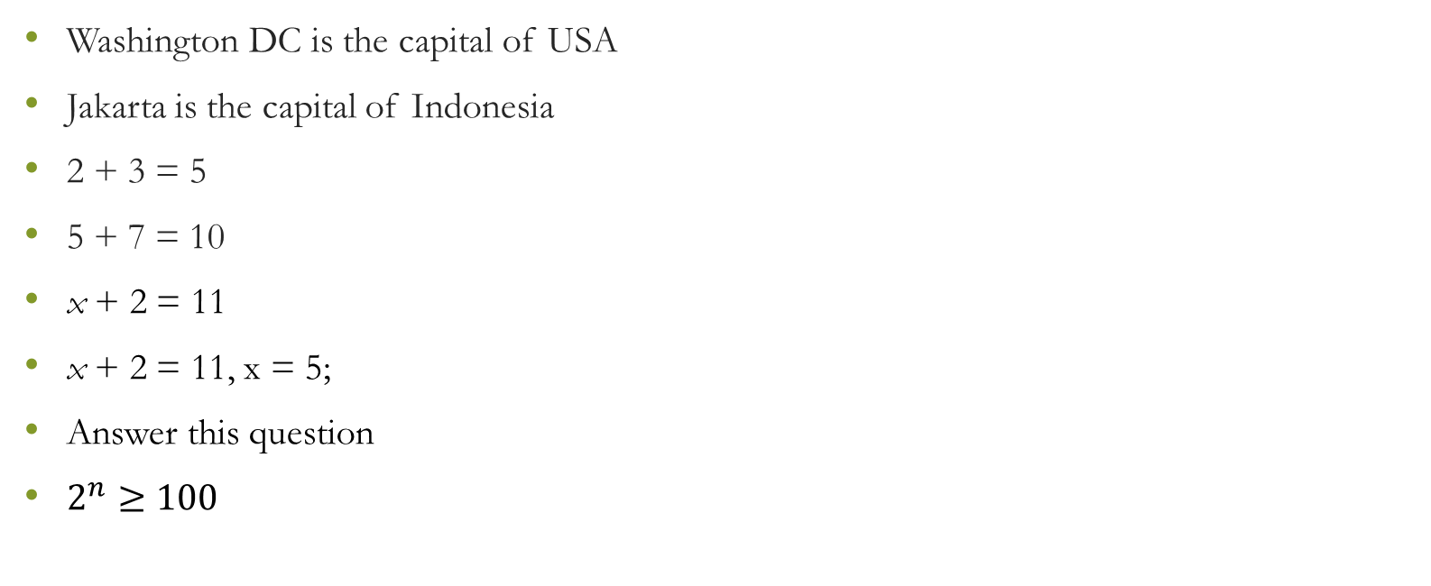
Which of the following statements are propositions?
Washington DC is the capital of USA
Jakarta is the capital of Indonesia
2 + 3 = 5
5 + 7 = 10
x + 2 = 11
x + 2 = 11, x = 5;
Answer this question
$2^{n}≥100$

Slide 7
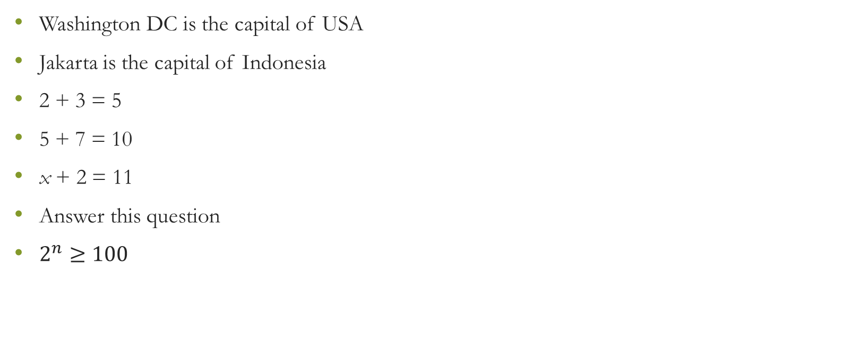
Which of the following statements are propositions?
Washington DC is the capital of USA
Jakarta is the capital of Indonesia
2 + 3 = 5
5 + 7 = 10
x + 2 = 11
Answer this question
$2^{n}≥100$

Slide 8
Compound Proposition: Logical Connectives

Slide 9
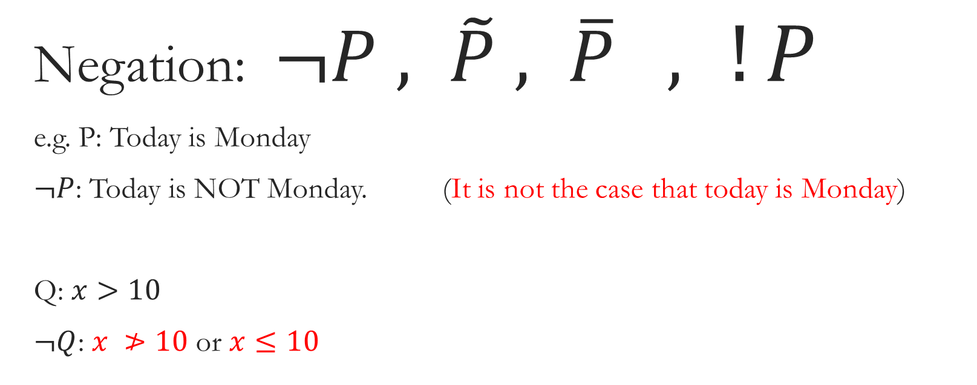
Negation: $¬P , \tilde{P} , \overline{P} ,$ $!P$
e.g. P: Today is Monday
$¬P$: Today is NOT Monday. (It is not the case that today is Monday)
Q: $x>10$
$¬Q$: $x ≯10$ or $x≤10$

Slide 10
Negation

Slide 11
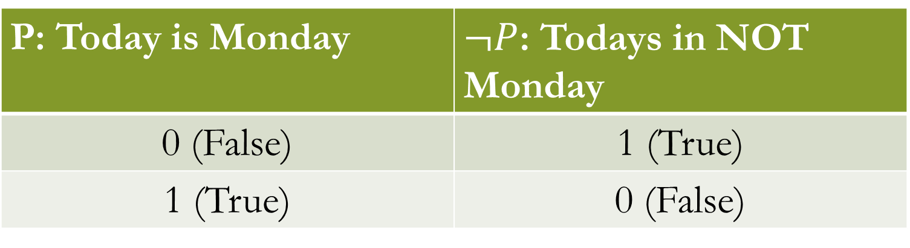
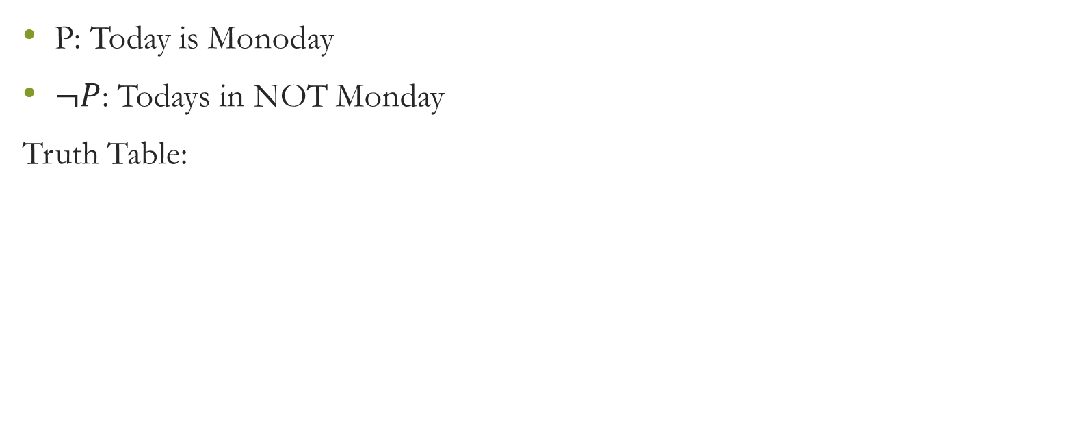
Negation
P: Today is Monoday
$¬P$: Todays in NOT Monday
Truth Table:
P: Today is Monday | $¬P$: Todays in NOT Monday
0 (False) | 1 (True)
1 (True) | 0 (False)

Slide 12
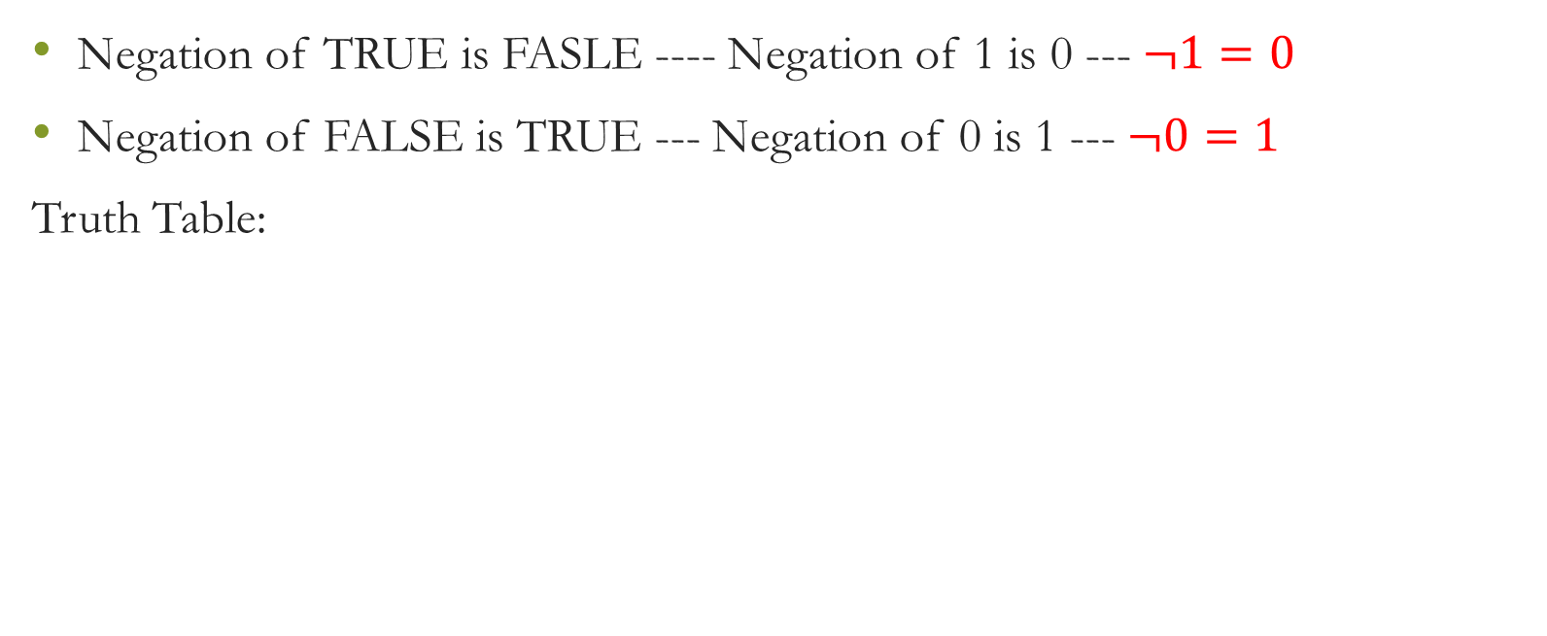
Negation
Negation of TRUE is FASLE ---- Negation of 1 is 0 --- $¬1=0$
Negation of FALSE is TRUE --- Negation of 0 is 1 --- $¬0=1$
Truth Table:
P: Today is Monday | $¬P$: Todays in NOT Monday
0 (False) | 1 (True)
1 (True) | 0 (False)

Slide 13
Logical AND

Slide 14
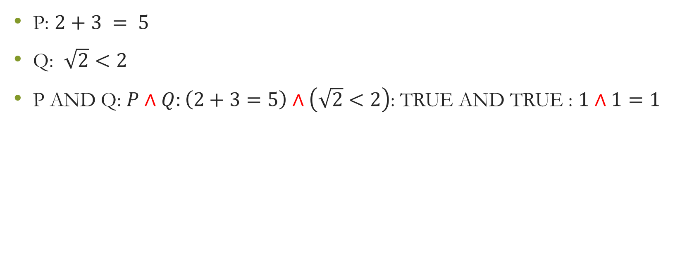
Logical AND
P: $2+3 = 5$
Q: $\sqrt{2}<2$
P AND Q: $P∧Q:\left(2+3=5\right)∧\left(\sqrt{2}<2\right)$: TRUE AND TRUE : $1∧1=1$

Slide 15
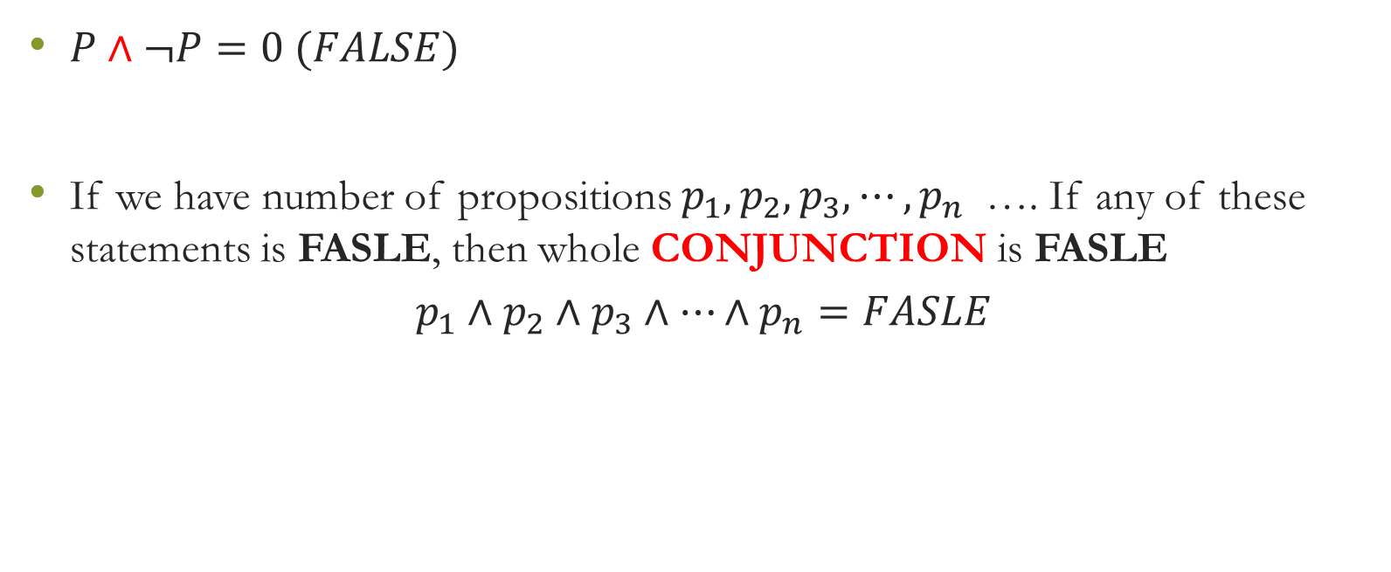
Logical AND
$P∧¬P=0 (FALSE)$
If we have number of propositions $p_{1},p_{2}, p_{3}, ⋯, p_{n}$ …. If any of these statements is FASLE, then whole CONJUNCTION is FASLE
$$p_{1}∧p_{2}∧p_{3}∧⋯∧p_{n}=FASLE$$

Slide 16
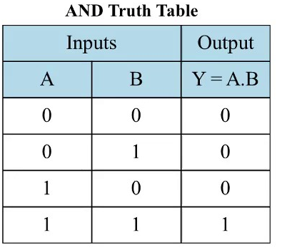

Slide 17
Logical OR

Slide 18
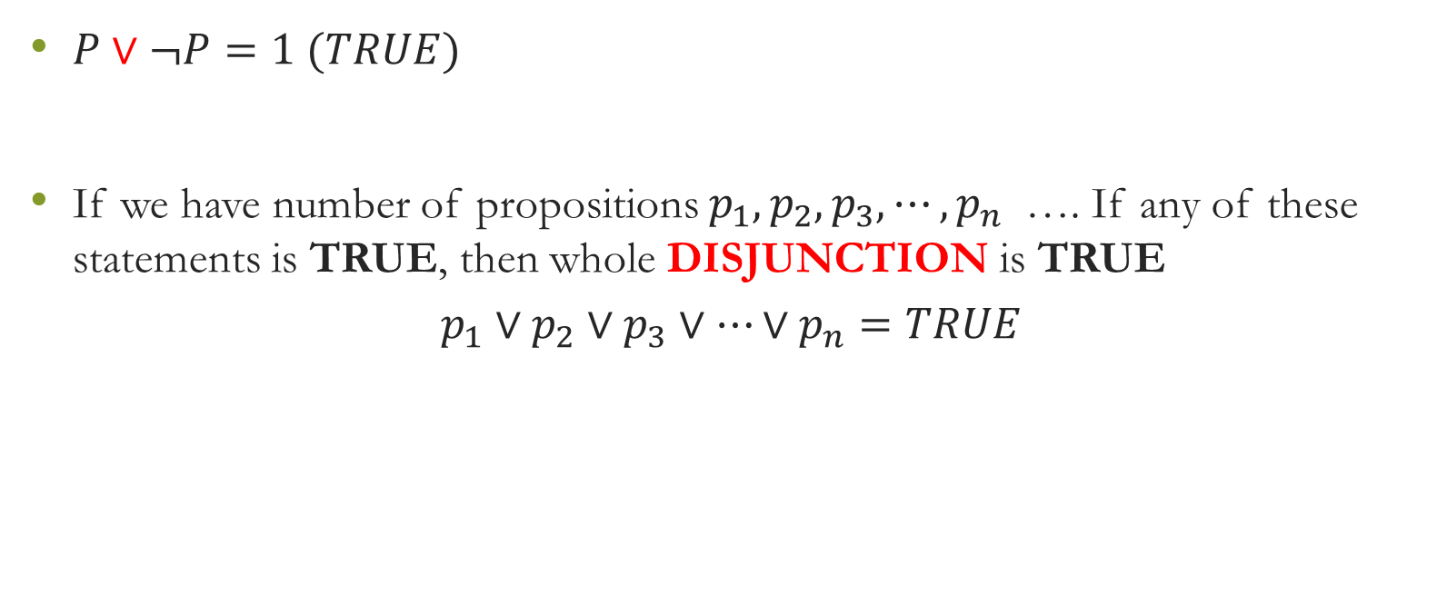
Logical OR
$P∨¬P=1 (TRUE)$
If we have number of propositions $p_{1},p_{2}, p_{3}, ⋯, p_{n}$ …. If any of these statements is TRUE, then whole DISJUNCTION is TRUE
$$p_{1}∨p_{2}∨p_{3}∨⋯∨p_{n}=TRUE$$

Slide 19
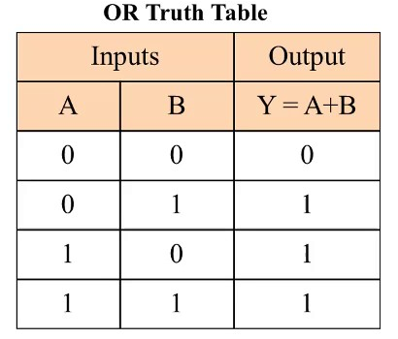

Slide 20
Logical XOR

Slide 21
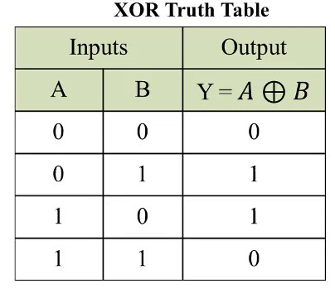

Slide 22
Implications

Slide 23
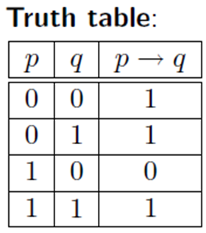
Implications

Slide 24
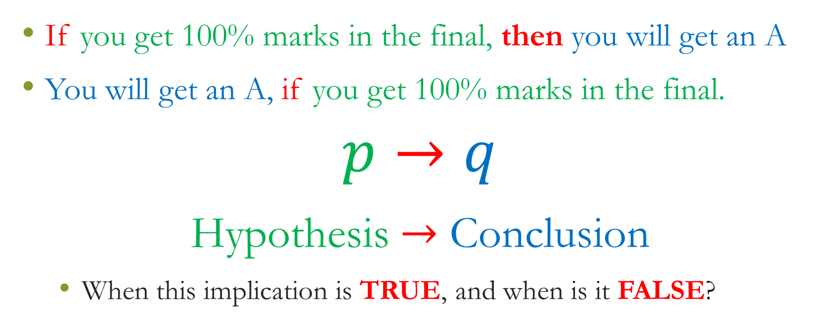
Implication: an example
If you get 100% marks in the final, then you will get an A
You will get an A, if you get 100% marks in the final.
$$p→q$$
Hypothesis $→$ Conclusion
When this implication is TRUE, and when is it FALSE?

Slide 25
Implication: an example
If you get 100% marks in the final, then you will get an A
When this implication is TRUE, and when is it FALSE?
Think of an implication as the promise that if P happen, then Q will definitely happen.
It is FALSE if P happens and Q does not happen (the promise has been broken)
In any other case, the promise is not broken, and the implication is TRUE.

Slide 26
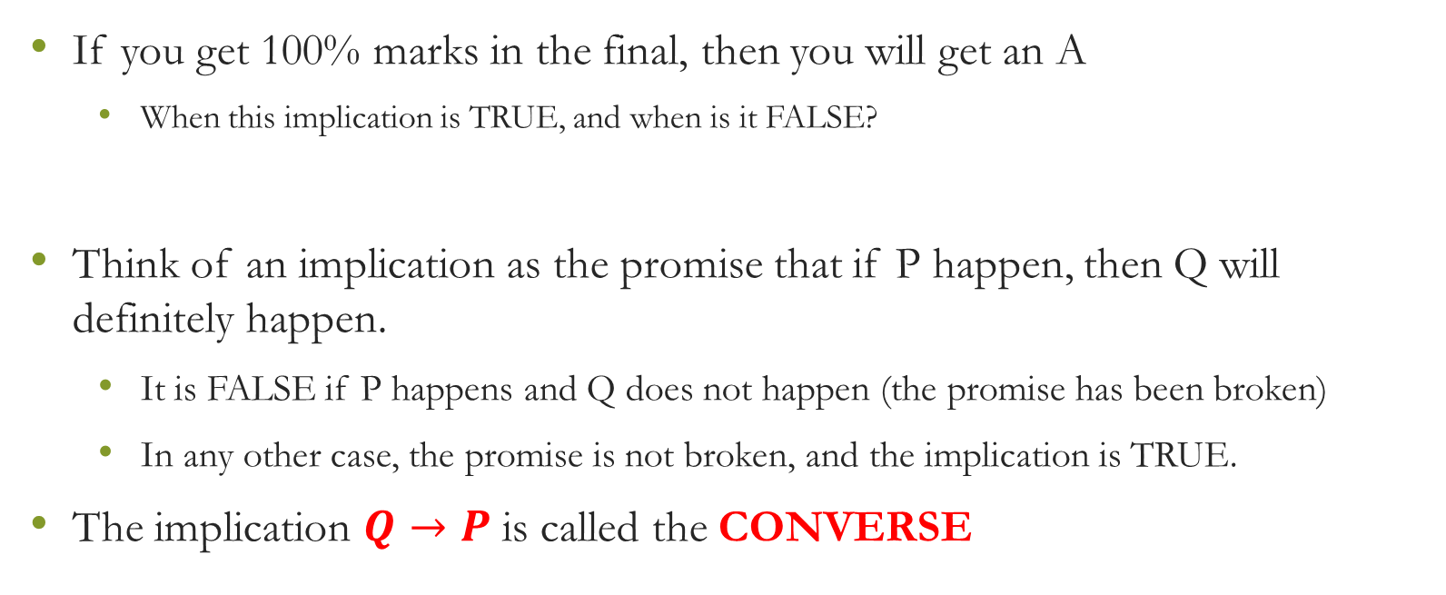
Implication: an example
If you get 100% marks in the final, then you will get an A
When this implication is TRUE, and when is it FALSE?
Think of an implication as the promise that if P happen, then Q will definitely happen.
It is FALSE if P happens and Q does not happen (the promise has been broken)
In any other case, the promise is not broken, and the implication is TRUE.
The implication $Q→P$ is called the CONVERSE

Slide 27
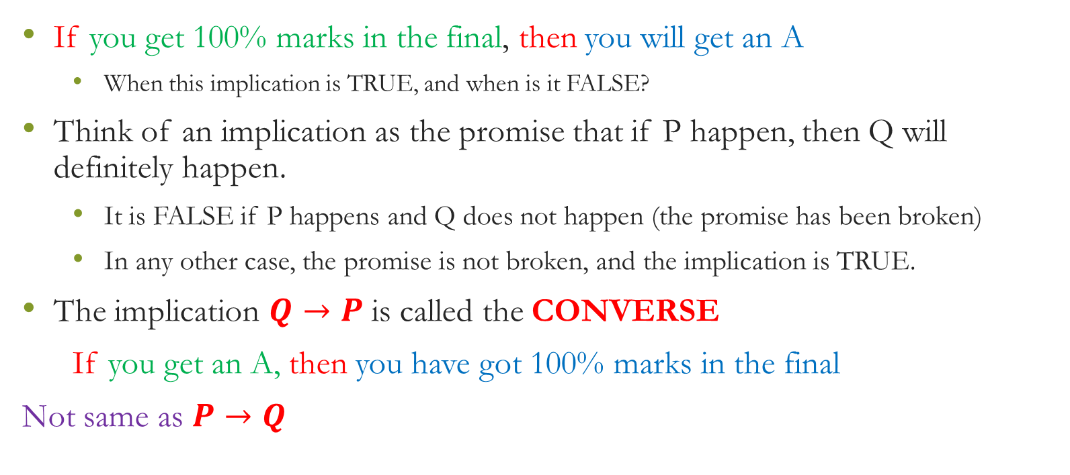
Implication: an example
If you get 100% marks in the final, then you will get an A
When this implication is TRUE, and when is it FALSE?
Think of an implication as the promise that if P happen, then Q will definitely happen.
It is FALSE if P happens and Q does not happen (the promise has been broken)
In any other case, the promise is not broken, and the implication is TRUE.
The implication $Q→P$ is called the CONVERSE
If you get an A, then you have got 100% marks in the final
Not same as $P→Q$

Slide 28
Implications

Slide 29
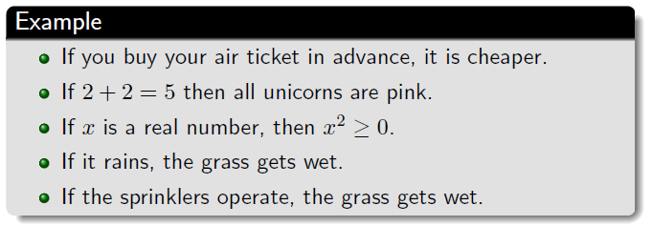
Examples

Slide 30
Exercise

Slide 31
Exercise

Slide 32
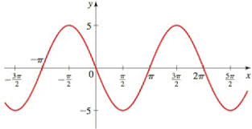
Exercise

Slide 33
Exercise

Slide 34
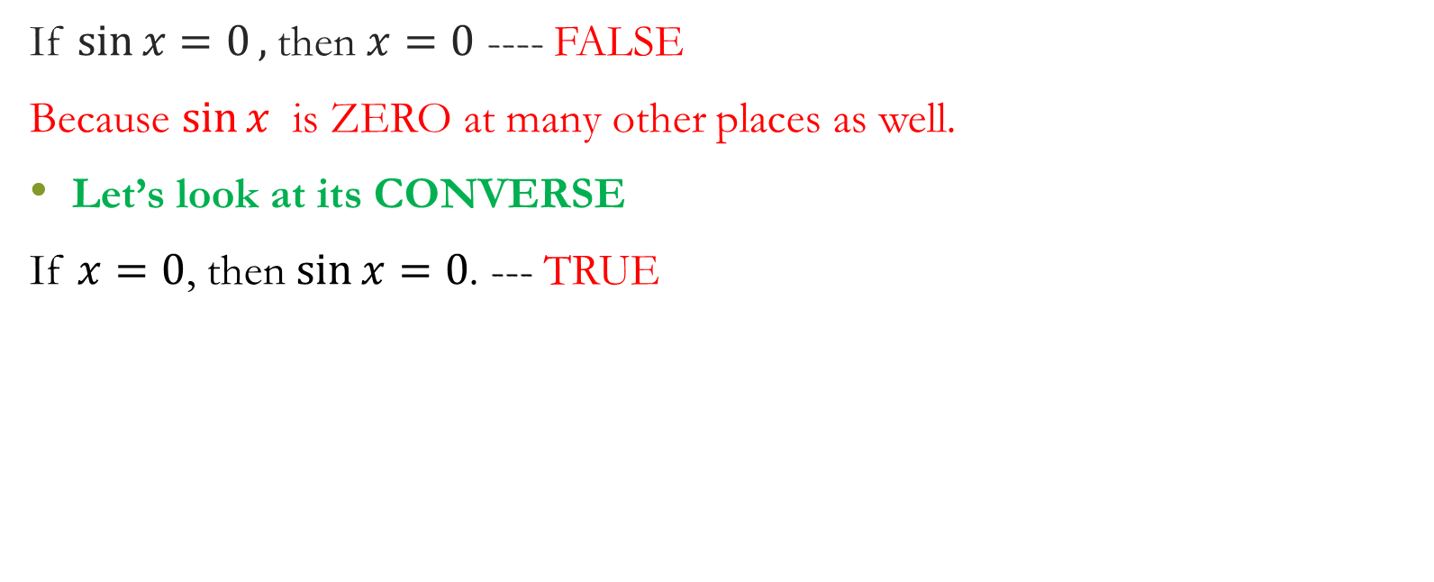
Exercise
If $\sin{x=0},$then $x=0$ ---- FALSE
Because $\sin{x }$ is ZERO at many other places as well.
Let’s look at its CONVERSE
If $x=0$, then $\sin{x=0}$. --- TRUE

Slide 35
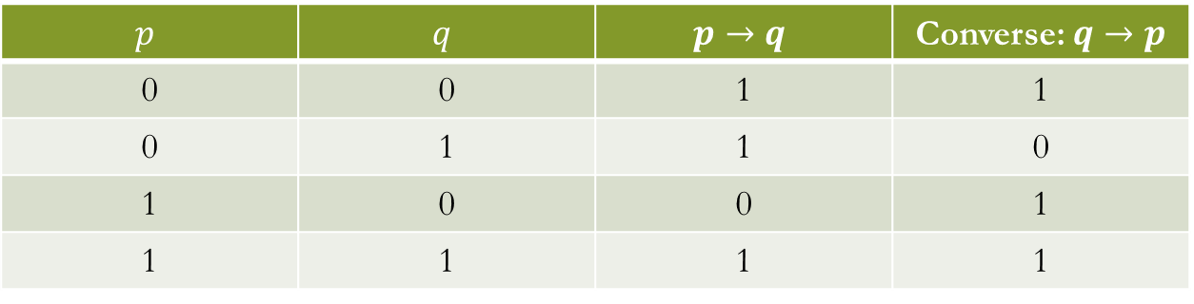
Exercise
If $\sin{x=0},$then $x=0$ ---- FALSE
Because $\sin{x }$ is ZERO at many other places as well.
Let’s look at its CONVERSE
If $x=0$, then $\sin{x=0}$. --- TRUE
$$p$$ | $$q$$ | $$p→q$$ | Converse: $q→p$
0 | 0 | 1 | 1
0 | 1 | 1 | 0
1 | 0 | 0 | 1
1 | 1 | 1 | 1

Slide 36
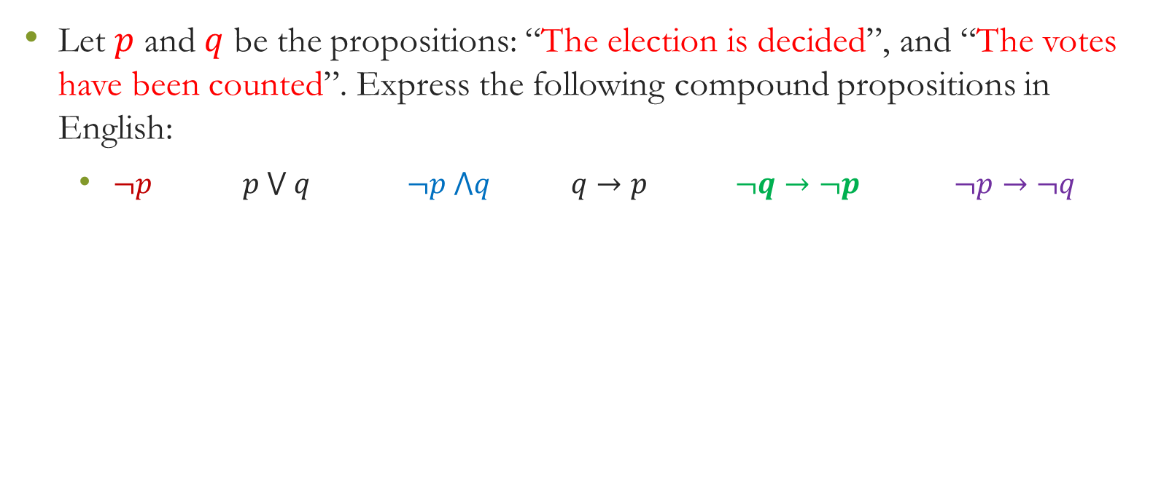
Quick – Do it by yourself - Be ready for class activity
Let $p$ and $q$ be the propositions: “The election is decided”, and “The votes have been counted”. Express the following compound propositions in English:
$¬p$ $p ⋁ q$ $¬p ⋀q$ $q→p$ $¬q→¬p$ $¬p→¬q$

Slide 37
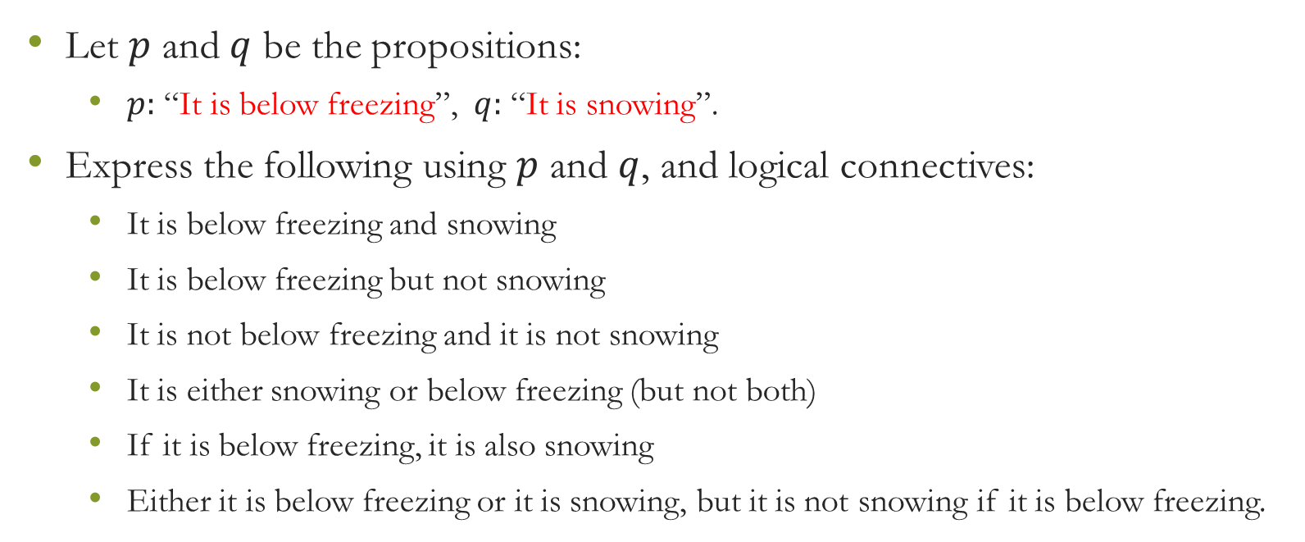
Quick – Do it by yourself - Be ready for class activity in next class
Let $p$ and $q$ be the propositions:
$p:$ “It is below freezing”, $q:$ “It is snowing”.
Express the following using $p$ and $q$, and logical connectives:
It is below freezing and snowing
It is below freezing but not snowing
It is not below freezing and it is not snowing
It is either snowing or below freezing (but not both)
If it is below freezing, it is also snowing
Either it is below freezing or it is snowing, but it is not snowing if it is below freezing.

Slide 38
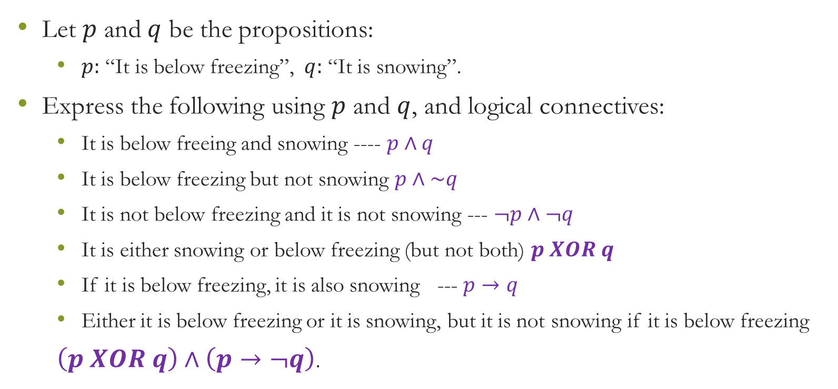
Quick – Do it by yourself - Be ready for class activity in next class
Let $p$ and $q$ be the propositions:
$p:$ “It is below freezing”, $q:$ “It is snowing”.
Express the following using $p$ and $q$, and logical connectives:
It is below freeing and snowing ---- $p∧q$
It is below freezing but not snowing $p∧\sim q$
It is not below freezing and it is not snowing --- $¬p∧¬q$
It is either snowing or below freezing (but not both) $p XOR q$
If it is below freezing, it is also snowing --- $p→q$
Either it is below freezing or it is snowing, but it is not snowing if it is below freezing
$\left(p XOR q\right)∧\left(p→¬q\right)$.

Slide 39
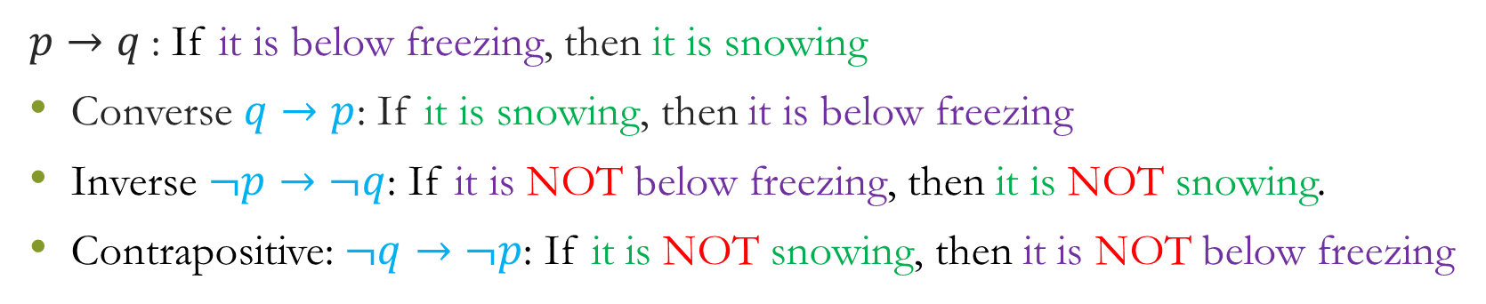
Converse, Contrapositive, Inverse
$p→q$: If it is below freezing, then it is snowing
Converse $q→p$: If it is snowing, then it is below freezing
Inverse $¬p→¬q$: If it is NOT below freezing, then it is NOT snowing.
Contrapositive: $¬q→¬p$: If it is NOT snowing, then it is NOT below freezing

Slide 40
Exercise: Correct or Incorrect

Slide 41
Exercise: Correct or Incorrect

Slide 42
Exercise: Correct or Incorrect

Slide 43
Exercise: Correct or Incorrect

Slide 44
Exercise: Correct or Incorrect

Slide 45
Exercise: Correct or Incorrect

Slide 46
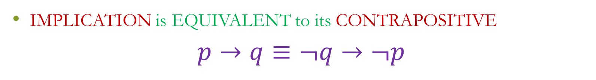
Exercise: Correct or Incorrect
IMPLICATION is EQUIVALENT to its CONTRAPOSITIVE
$$p→q≡¬q→¬p$$

Slide 47
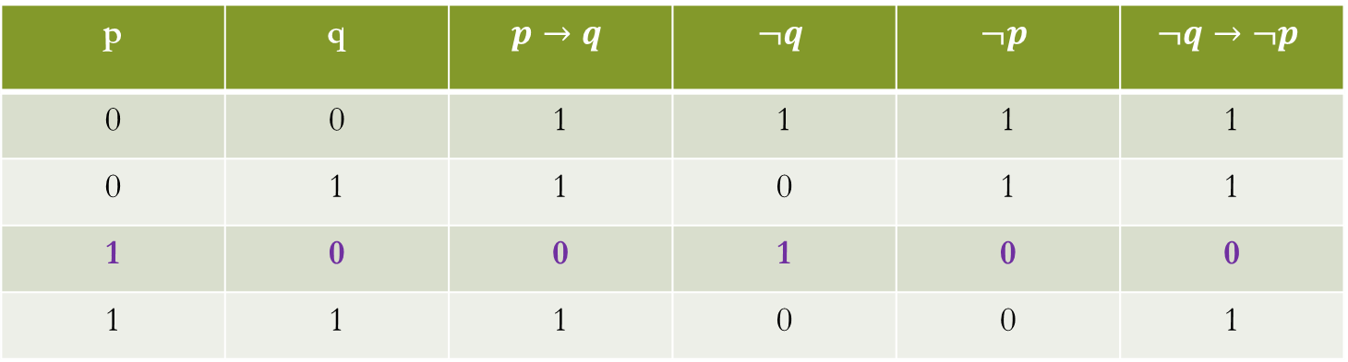

Exercise: Correct or Incorrect
IMPLICATION is EQUIVALENT to its CONTRAPOSITIVE
$$p→q≡¬q→¬p$$
p | q | $$p→q$$ | $$¬q$$ | $$¬p$$ | $$¬q→¬p$$
0 | 0 | 1 | 1 | 1 | 1
0 | 1 | 1 | 0 | 1 | 1
1 | 0 | 0 | 1 | 0 | 0
1 | 1 | 1 | 0 | 0 | 1

Slide 48
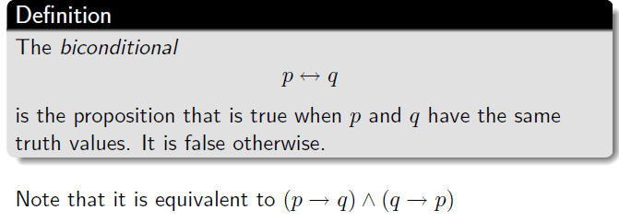
Biconditional Proposition

Slide 49
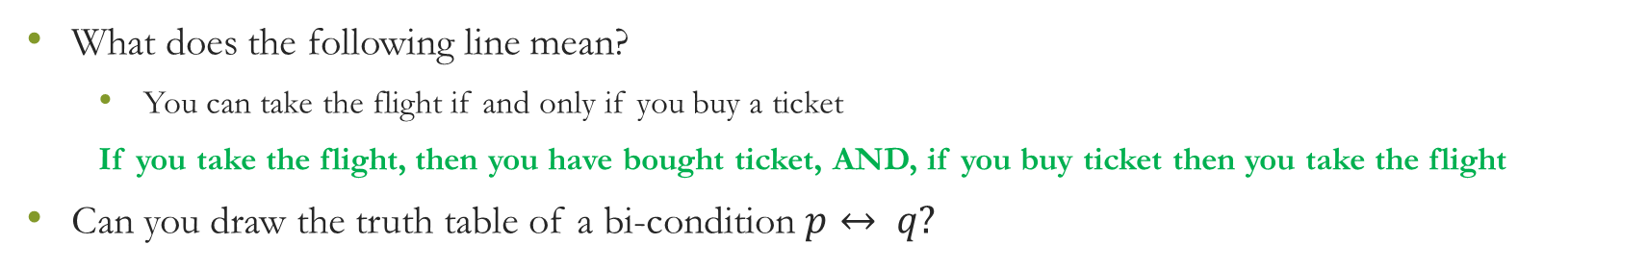
Biconditional
What does the following line mean?
You can take the flight if and only if you buy a ticket
If you take the flight, then you have bought ticket, AND, if you buy ticket then you take the flight
Can you draw the truth table of a bi-condition $p↔ q?$

Slide 50
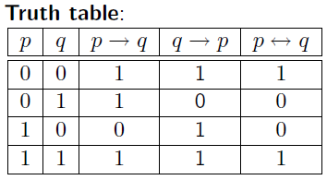
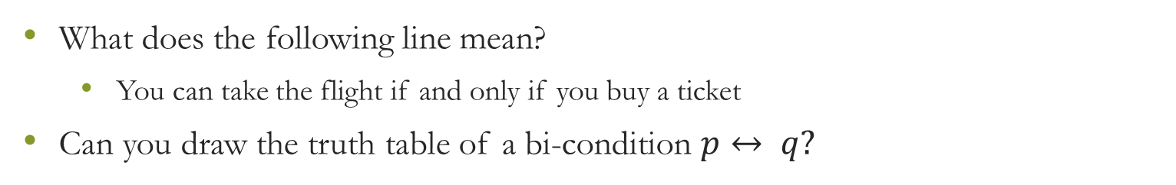
Biconditional
What does the following line mean?
You can take the flight if and only if you buy a ticket
Can you draw the truth table of a bi-condition $p↔ q?$

Slide 51
Examples

Slide 52
Exercise

Slide 53
Exercise

Slide 54
Exercise

Slide 55
Exercise

Slide 56
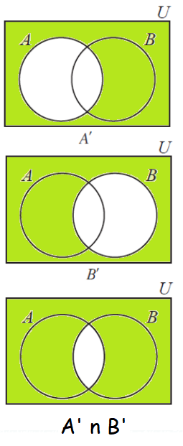
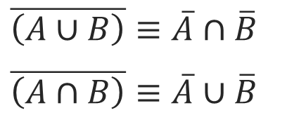
De Morgan’s Law
$\overline{\left(A∪B\right)}≡\overline{A}∩\overline{B}$
$\overline{\left(A∩B\right)}≡\overline{A}∪\overline{B}$

Slide 57
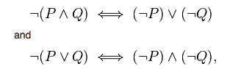
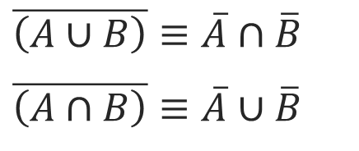
De Morgan’s Law
$\overline{\left(A∪B\right)}≡\overline{A}∩\overline{B}$
$\overline{\left(A∩B\right)}≡\overline{A}∪\overline{B}$
Union is similar to OR operation
Intersection is similar to AND operation

Slide 58
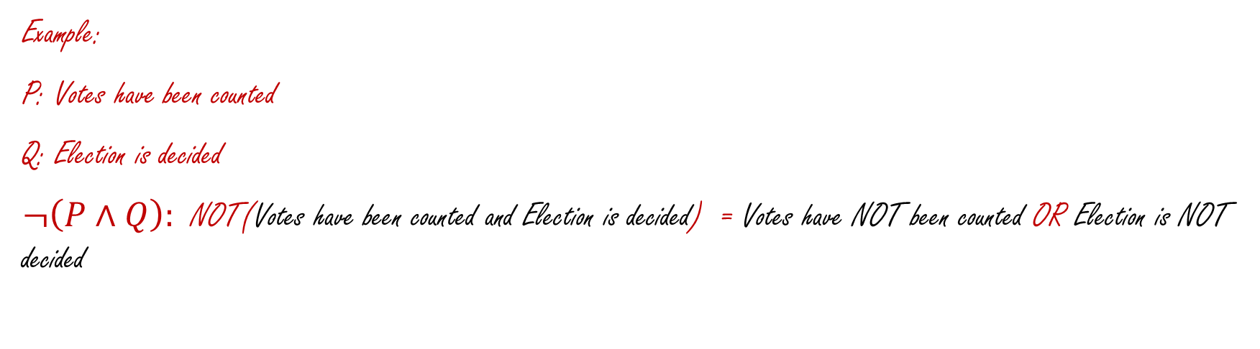
De Morgan’s Law
Example:
P: Votes have been counted
Q: Election is decided
$¬\left(P∧Q\right):$ NOT(Votes have been counted and Election is decided) = Votes have NOT been counted OR Election is NOT decided

Slide 59
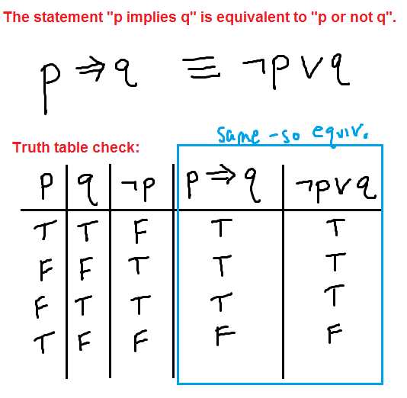
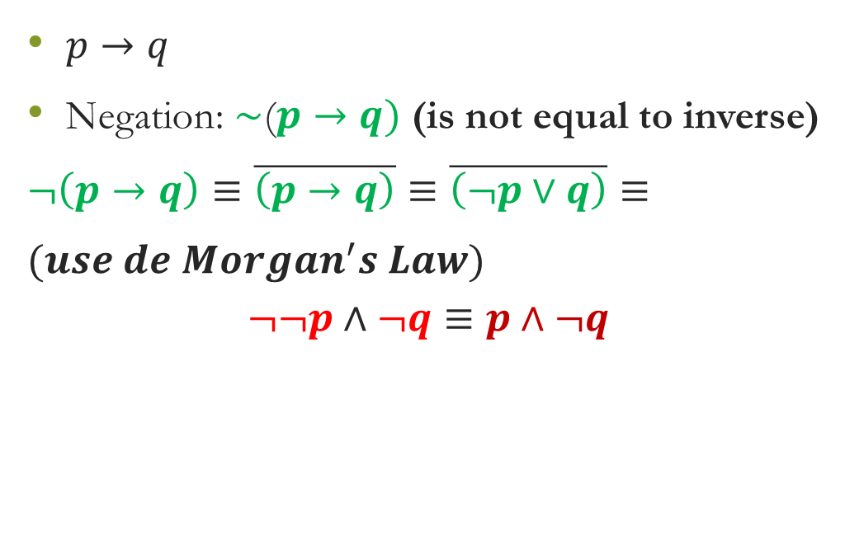
Negation of Implication
$p→q$
Negation: $\sim$($p→q)$ (is not equal to inverse)
$¬\left(p→q\right)≡\overline{\left(p→q\right)}≡\overline{\left(¬p∨q\right)}≡$
$(use de Morgan^{′}s Law)$
$$¬¬p∧¬q≡p∧¬q$$

Slide 60
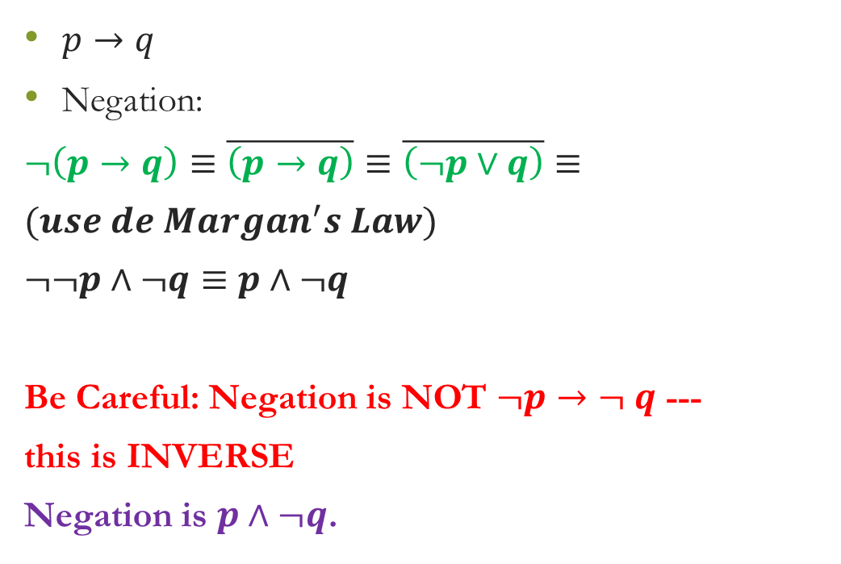
Negation of Implication
$p→q$
Negation:
$¬\left(p→q\right)≡\overline{\left(p→q\right)}≡\overline{\left(¬p∨q\right)}≡$
$(use de Margan^{′}s Law)$
$¬¬p∧¬q≡p∧¬q$
Be Careful: Negation is NOT $¬p→¬ q$ ---
this is INVERSE
Negation is $p∧¬q$.

Slide 61
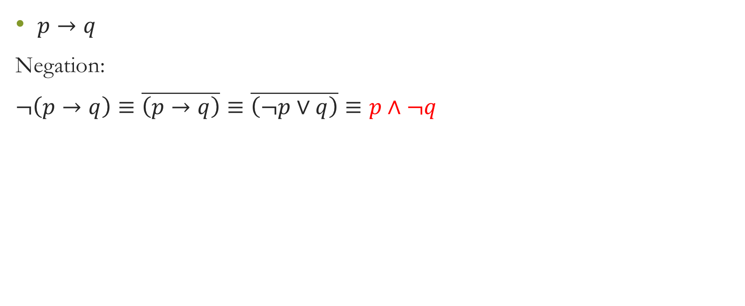
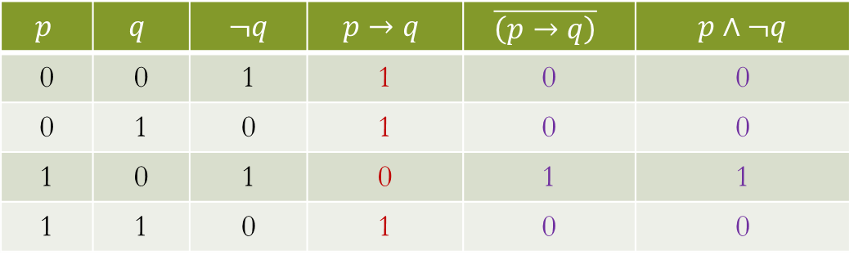
Negation of Implication – Truth Table
$p→q$
Negation:
$¬\left(p→q\right)≡\overline{\left(p→q\right)}≡\overline{\left(¬p∨q\right)}≡p∧¬q$
$$p$$ | $$q$$ | $¬q$ | $$p→q$$ | $$\overline{\left(p→q\right)}$$ | $p∧¬q$
0 | 0 | 1 | 1 | 0 | 0
0 | 1 | 0 | 1 | 0 | 0
1 | 0 | 1 | 0 | 1 | 1
1 | 1 | 0 | 1 | 0 | 0

Slide 62
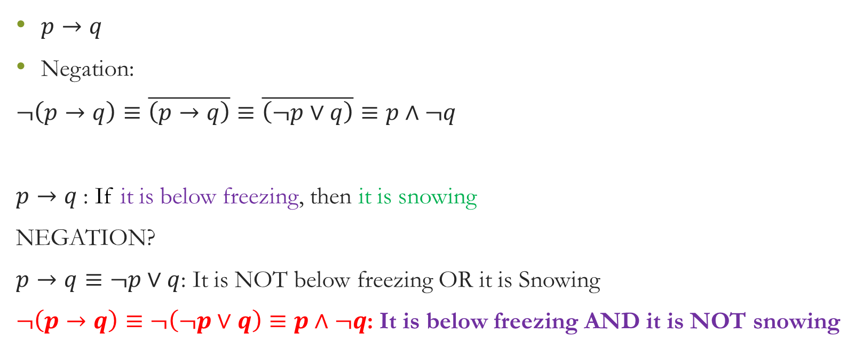
Negation of Implication – Example
$p→q$
Negation:
$¬\left(p→q\right)≡\overline{\left(p→q\right)}≡\overline{\left(¬p∨q\right)}≡p∧¬q$
$p→q$: If it is below freezing, then it is snowing
NEGATION?
$p→q≡¬p∨q$: It is NOT below freezing OR it is Snowing
$¬\left(p→q\right)≡¬\left(¬p∨q\right)≡p∧¬q$: It is below freezing AND it is NOT snowing

Slide 63
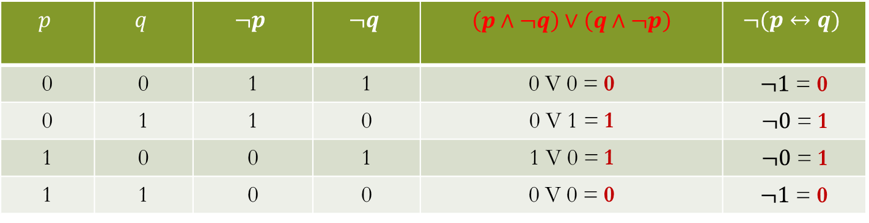
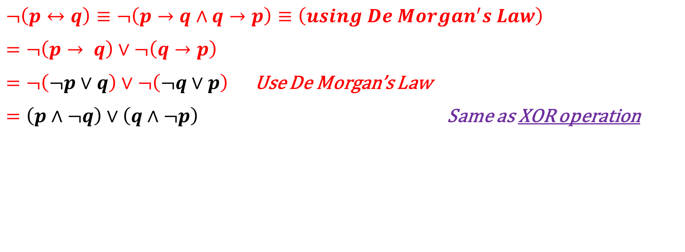
Negation of Bicondition
$¬\left(p↔q\right)≡¬\left(p→q∧q→p\right)≡\left(using De Morgan^{′}s Law\right)$
$=¬\left(p→ q\right)∨¬\left(q→p\right)$
$=¬\left(¬p∨q\right)∨¬\left(¬q∨p\right)$ Use De Morgan’s Law
$=\left(p∧¬q\right)∨\left(q∧¬p\right)$ Same as XOR operation
$$p$$ | $$q$$ | $$¬p$$ | $$¬q$$ | $\left(p∧¬q\right)∨\left(q∧¬p\right)$ | $$¬(p↔q)$$
0 | 0 | 1 | 1 | 0 V 0 = 0 | $¬1$ = 0
0 | 1 | 1 | 0 | 0 V 1 = 1 | $¬0$ = 1
1 | 0 | 0 | 1 | 1 V 0 = 1 | $¬0$ = 1
1 | 1 | 0 | 0 | 0 V 0 = 0 | $¬1$ = 0

Slide 64
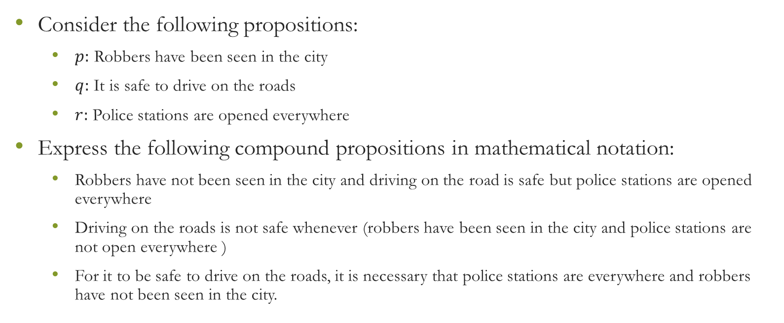
Express the following in mathematical notation:
Consider the following propositions:
$p:$ Robbers have been seen in the city
$q:$ It is safe to drive on the roads
$r:$ Police stations are opened everywhere
Express the following compound propositions in mathematical notation:
Robbers have not been seen in the city and driving on the road is safe but police stations are opened everywhere
Driving on the roads is not safe whenever (robbers have been seen in the city and police stations are not open everywhere )
For it to be safe to drive on the roads, it is necessary that police stations are everywhere and robbers have not been seen in the city.

Slide 65
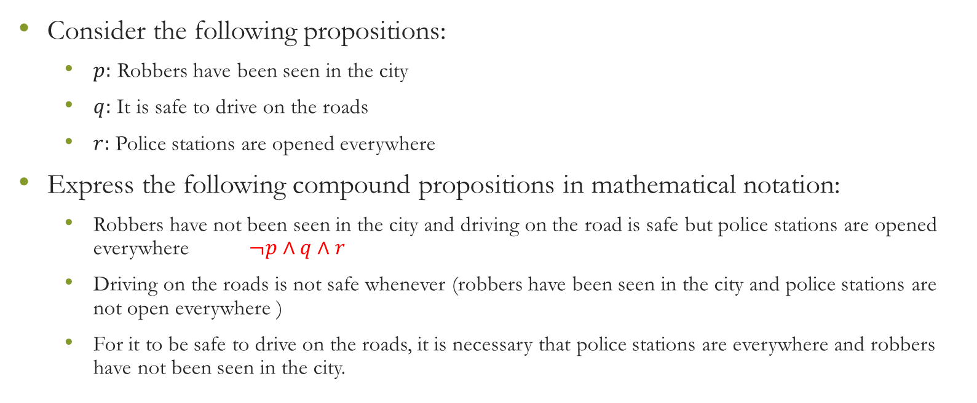
Express the following in mathematical notation:
Consider the following propositions:
$p:$ Robbers have been seen in the city
$q:$ It is safe to drive on the roads
$r:$ Police stations are opened everywhere
Express the following compound propositions in mathematical notation:
Robbers have not been seen in the city and driving on the road is safe but police stations are opened everywhere $¬p∧q∧r$
Driving on the roads is not safe whenever (robbers have been seen in the city and police stations are not open everywhere )
For it to be safe to drive on the roads, it is necessary that police stations are everywhere and robbers have not been seen in the city.

Slide 66
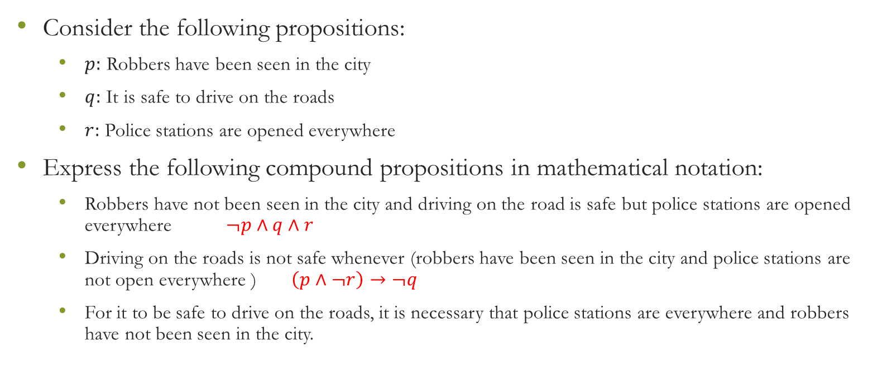
Express the following in mathematical notation:
Consider the following propositions:
$p:$ Robbers have been seen in the city
$q:$ It is safe to drive on the roads
$r:$ Police stations are opened everywhere
Express the following compound propositions in mathematical notation:
Robbers have not been seen in the city and driving on the road is safe but police stations are opened everywhere $¬p∧q∧r$
Driving on the roads is not safe whenever (robbers have been seen in the city and police stations are not open everywhere ) $\left(p∧¬r\right)→¬q$
For it to be safe to drive on the roads, it is necessary that police stations are everywhere and robbers have not been seen in the city.

Slide 67
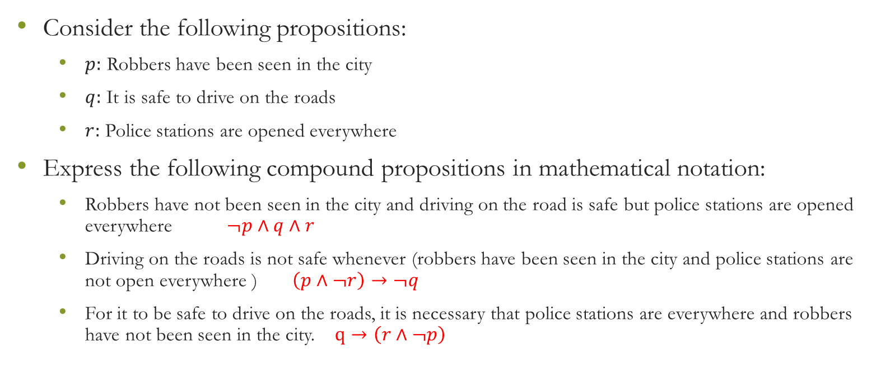
Express the following in mathematical notation:
Consider the following propositions:
$p:$ Robbers have been seen in the city
$q:$ It is safe to drive on the roads
$r:$ Police stations are opened everywhere
Express the following compound propositions in mathematical notation:
Robbers have not been seen in the city and driving on the road is safe but police stations are opened everywhere $¬p∧q∧r$
Driving on the roads is not safe whenever (robbers have been seen in the city and police stations are not open everywhere ) $\left(p∧¬r\right)→¬q$
For it to be safe to drive on the roads, it is necessary that police stations are everywhere and robbers have not been seen in the city. $q→\left(r∧¬p\right)$

Slide 68
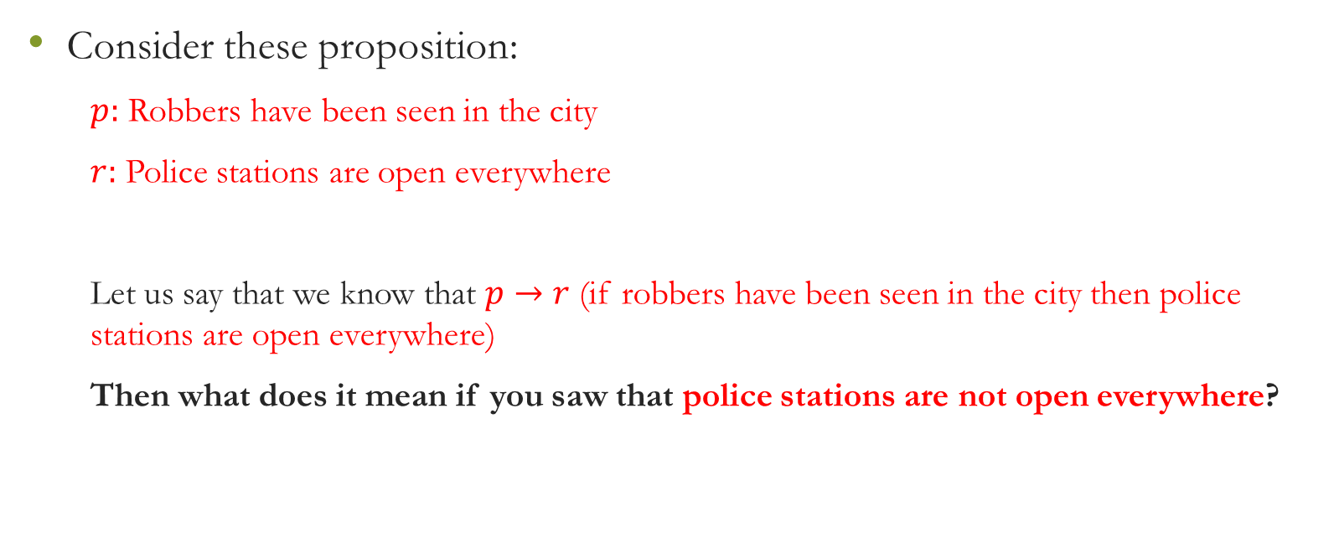
Contrapositive
Consider these proposition:
$p:$ Robbers have been seen in the city
$r:$ Police stations are open everywhere
Let us say that we know that $p→r$ (if robbers have been seen in the city then police stations are open everywhere)
Then what does it mean if you saw that police stations are not open everywhere?

Slide 69
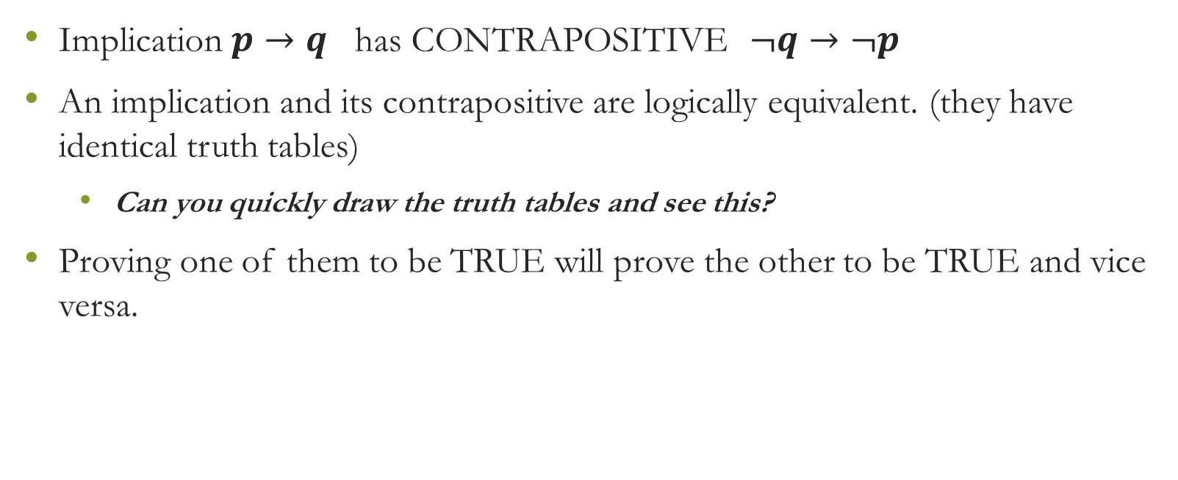
Contrapositive
Implication $p→q$ has CONTRAPOSITIVE $¬q→¬p$
An implication and its contrapositive are logically equivalent. (they have identical truth tables)
Can you quickly draw the truth tables and see this?
Proving one of them to be TRUE will prove the other to be TRUE and vice versa.

Slide 70
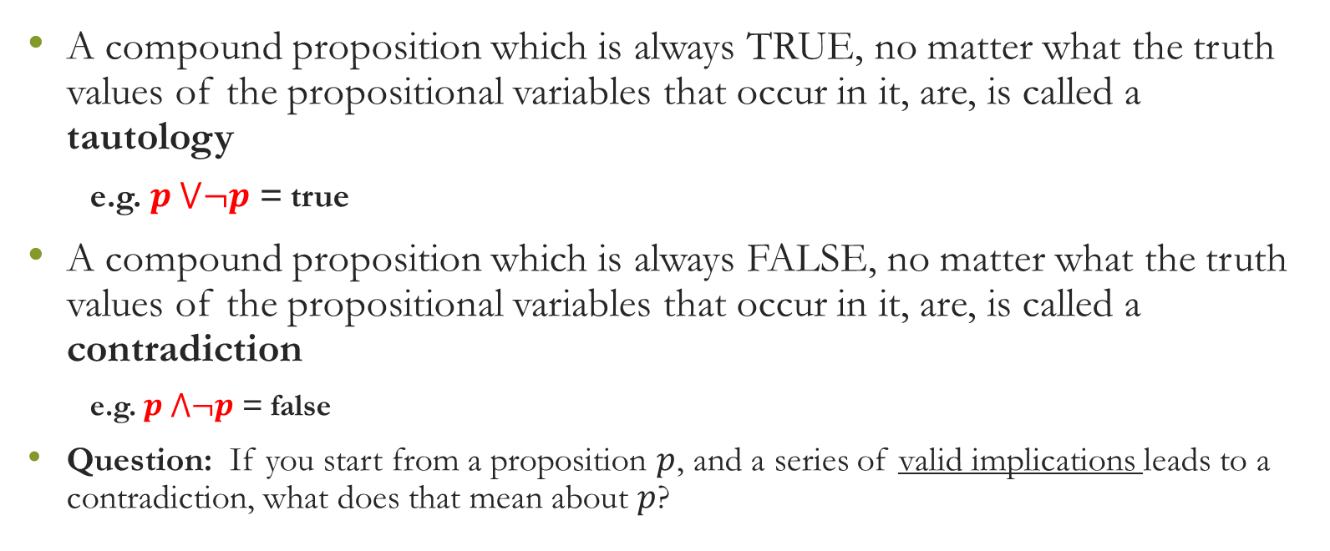
Tautologies and Contradictions
A compound proposition which is always TRUE, no matter what the truth values of the propositional variables that occur in it, are, is called a tautology
e.g. $p ⋁¬p$ = true
A compound proposition which is always FALSE, no matter what the truth values of the propositional variables that occur in it, are, is called a contradiction
e.g. $p ⋀¬p$ = false
Question: If you start from a proposition $p$, and a series of valid implications leads to a contradiction, what does that mean about $p$?

Slide 71
Truth Tables

Slide 72
Exercise

Slide 73
Exercise

Slide 74
Propositional Logic - II
[Universal and Existential Quantifiers]

Slide 75
English-to-Symbolic Form
Some stones are precious.
All grapes are red.
There is an honest politician
Some celebrities are invited.
Few students are present.

Slide 76

English-to-Symbolic Form
Function : Input is connected with output
Mathematics: $f \left(x\right)=x^{2} or g\left(x, y\right) f(g(x)$
Name (f) , parameter (x), domain-range, definition
Name (g), parameter (x, y), domain-range, definition
Programming: $void main \left(void\right)$
Name, return-type, parameters, definition, call-function
Square == $Int Square \left(a\right)\{ \}$
Factorial == $Int Factorial (n)$
Logic: Propositional-function

Slide 77

English-to-Symbolic Form
All grapes are red.
x: set of grapes (universe of discourse)
Red (x) : x is a red grape
all grapes are red: $∀x Red \left(x\right)$
This is not a proposition.– Proposition Formula

Slide 78

English-to-Symbolic Form
All students are hungry.
x: set of students (universe of discourse)
Hungry (x) : x is a red grape
all students are hungry: $∀x Hungry \left(x\right)$
This is not a proposition.– Proposition Formula

Slide 79

English-to-Symbolic Form
Some stones are precious.
x: set of stones (universe of discourse)
Precious (x) : x is precious
some stones are precious: $∃x Precious \left(x\right)$
This is not a proposition.– Proposition Formula

Slide 80
Propositional Function - Predicate

Slide 81
Propositional Function

Slide 82
Quantifiers

Slide 83
Universal Quantifiers

Slide 84
Example
Let P(x) be “x must take Discrete Mathematics course”,
And let Q(x) be “x is a Computer Science student”.
The Universe of discourse is all UCP students.
Express the statement mathematically: “Every computer science student must take discrete mathematics course”

Slide 85

Example
Let $P(x)$ be “x must take Discrete Mathematics course”,
And let $Q(x)$ be “x is a Computer Science student”.
The Universe of discourse is all UCP students ($x$).
Express the statement: “Every computer science student must take discrete mathematics course”

Slide 86
Example
Let P(x) be “x must take Discrete Mathematics course”,
And let Q(x) be “x is a Computer Science student”.
The Universe of discourse is all UCP students.
Express the statement: “Every computer science student must take discrete mathematics course”
Express the statement: “Everybody must take a discrete mathematics course or be a computer science student”

Slide 87
Example
Let P(x) be “x must take Discrete Mathematics course”,
And let Q(x) be “x is a Computer Science student”.
The Universe of discourse is all UCP students.
Express the statement: “Every computer science student must take discrete mathematics course”
Express the statement: “Everybody must take a discrete mathematics course or be a computer science student”

Slide 88
Example
Let P(x) be “x must take Discrete Mathematics course”,
And let Q(x) be “x is a Computer Science student”.
The Universe of discourse is all UCP students.
Express the statement: “Every computer science student must take discrete mathematics course”
Express the statement: “Everybody must take a discrete mathematics course or be a computer science student”.
Are these statements True or False?

Slide 89
Existential Quantifier

Slide 90

Truth Values of Quantifiers

Slide 91
Examples – Express in Mathematical Notation
Product of two negative integers is positive.

Slide 92

Examples – Express in Mathematical Notation
Product of two negative integers is positive.
$$∀x,y∈Z^{−}, x⋅y>0$$

Slide 93
Examples – Express in Mathematical Notation
Product of two negative integers is positive.
Average of two positive integers in positive.

Slide 94

Examples – Express in Mathematical Notation
Product of two negative integers is positive.
Average of two positive integers is positive.
$∀a,b∈Z^{+}, \frac{\left(a+b\right)}{2}>0$

Slide 95
Examples – Express in Mathematical Notation
Product of two negative integers is positive.
Average of two positive integers in positive.
The difference of two negative integers is not necessarily negative.

Slide 96

Examples – Express in Mathematical Notation
Product of two negative integers is positive.
Average of two positive integers in positive.
The difference of two negative integers is not necessarily negative.
$$∀a,b∈Z^{−}, a−b>0 or a−b<0$$
Or we may write
$$∃a,b∈Z^{−}, a−b>0$$

Slide 97

Examples – Express in Mathematical Notation
Product of two negative integers is positive.
Average of two positive integers in positive.
The difference of two negative integers is not necessarily negative.
Absolute value of sum of two integers does not exceed the sum of the absolute values of these integers.
$$∀x,y∈Z, \left|x+y\right|≤\left|x\right|+\left|y\right|$$

Slide 98

Quantifiers – Negation

Slide 99

Quantifiers – Negation
$∀xP\left(x\right)≡P\left(x_{1}\right)∧P\left(x_{2}\right)∧…∧P\left(x_{n}\right)$
$¬∀xP\left(x\right)≡¬[P\left(x_{1}\right)∧P\left(x_{2}\right)∧…∧P\left(x_{n}\right) ]$
Use De Morgan’s Law
$¬∀xP\left(x\right)≡¬P\left(x_{1}\right)∨¬P\left(x_{2}\right)∨…∨¬P\left(x_{n}\right) ≡∃x¬P\left(x\right)$

Slide 100

Quantifiers – Negation
$∃xP\left(x\right)≡P\left(x_{1}\right)∨P\left(x_{2}\right)∨…∨ P\left(x_{n}\right)$
$¬∃xP\left(x\right)≡¬[P\left(x_{1}\right)∨P\left(x_{2}\right)∨…∨P\left(x_{n}\right) ]$
Use De Morgan’s Law
$¬∃xP\left(x\right)≡¬P\left(x_{1}\right)∧¬P\left(x_{2}\right)∧…∧¬P\left(x_{n}\right) ≡∀x¬P\left(x\right)$

Slide 101

Quantifiers – Negation – Truth Values

Slide 102

Example – 1

Slide 103

Example – 1
Negation
All politicians are dishonest
Writing in mathematical notation:
$x$: set of all politicians
$H\left(x\right):x$ is honest
There is an honest politician: $∃xH\left(x\right)$
Negation: All politicians are dishonest: $∀x¬H\left(x\right)$

Slide 104


Example – 1
Negation
There is an American who does not eat cheeseburger
$x$: set of Americans
$E(x)$: $x$ eats Cheeseburger
$$∀x E(x)$$
Negation: $∃x¬E\left(x\right)$

Slide 105


Example – 2
Negation
$$¬∀x\left(x^{2}>x\right)≡∃x \left(x^{2}≤x\right)$$
2nd statement
$$¬∃x\left(x^{2}=2\right)≡∀x \left(x^{2}≠2\right)$$

Slide 106


Mixing Quantifiers – Nested Quantifiers
$$∀x∀y P \left(x, y\right)$$
$$∀x∃y P \left(x, y\right)$$
$$∃x∀y P \left(x, y\right)$$
$$∃x∃y P \left(x, y\right)$$

Slide 107



Mixing Quantifiers
$$x: people$$
$$y: people$$
$$Loves (x, y): x loves y$$
Everybody loves everyone
$∀x ∀y Loves (x, y)$
Everybody loves somebody
$$∀x ∃y Loves (x, y)$$
Somebody loves somebody
$$∃x ∃y Loves (x, y)$$

Slide 108

Mixing Quantifiers
$x$ is a person
$y$ is a country
National$(x,y)$: $x$ is national of $y$
$∀x∃y$: National $(x,y)$
Everyone belongs to some country
$∃y∀x$: National $\left(x,y\right)$
There is a country, everybody belongs to this country.

Slide 109


Nested Quantifiers – Truth Values
Negation
$$∃x∃y ¬P\left(x,y\right)$$
$$∃x∀y ¬P\left(x,y\right)$$
$$∀x∃y ¬P\left(x,y\right)$$
$$∀x∀y ¬P\left(x,y\right)$$

Slide 110


Example – 3
$$¬∀x \left(P\left(x\right)→Q\left(x\right)\right)=∃x ¬\left(P\left(x\right)→Q\left(x\right)\right)$$
Implication is equivalent to NOT P(x) or Q(x)
$$∃x ¬\left(¬P\left(x\right)∨Q\left(x\right)\right)$$
Use De Morgan’s Law
$∃x \left(P\left(x\right)∧¬Q\left(x\right)\right)$

Slide 111
Example – 4

Slide 112


Example – 4
$x$: Students in the class
$M\left(x\right):x$ has visited Mexico
$$∃x M(x)$$
====================
$M\left(x\right):x$ has visited Mexico
$C\left(x\right):x$ has visited Canada
$$∀x :M\left(x\right)∨C\left(x\right)$$
$x$: Students
$Class\left(x\right):x$ is student in this class
$M\left(x\right):x$ has visited Mexico
$$∃x Class\left(x\right) \text{∧} M(x)$$
====================
$M\left(x\right):x$ has visited Mexico
$C\left(x\right):x$ has visited Canada
$$∀x :Class\left(x\right)→M\left(x\right)∨C\left(x\right)$$

Slide 113
Example – 5

Slide 114

Example – 5
1st statement
$x:$mail message
$C\left(x\right):x$ is compressed
$∀x:C\left(x>1Megabyte\right)$
-----------------------------
$∀x>1Megabyte:C\left(x\right)$

Slide 115


Example – 5
1st statement
$x:$mail message
$C\left(x\right):x$ is compressed
$∀x:C\left(x>1Megabyte\right)$
--------------------
$∀x>1Megabyte:C\left(x\right)$
2nd statement
$x:$user, $y:$ network link
$Acive\left(x\right):x$ is an active user
$Available\left(y,x\right):link y$ is available to user $x$
$∃x∃y:Active\left(x\right)→Available(y,x)$

Slide 116


Exercises – Lewis Carroll (Alice in Wonderland)

Slide 117

Exercises – Lewis Carroll (Alice in Wonderland)
$x:$ creatures
$P\left(x\right):x$ is a lion
$Q\left(x\right):x$is fierce
$R\left(x\right):x$ drinks coffee

Slide 118


$r∧¬q$
$p∧q∧r$
$p→ r$
$p∧¬q∧r$
$(p∧q)→r$
$r↔\left(p∨q\right)$

Slide 119

No doctors are enthusiastic;
You are enthusiastic.
Therefore, you are not a doctor
$x:$a person
$D\left(x\right):x$ is a Doctor
$E\left(x\right):x$ is enthusiastic
$$∀x:D\left(x\right)→¬E\left(x\right)$$
$$E\left(you\right)$$
$¬D\left(you\right)$

Slide 120

For all real numbers, there is a real number, which is greater than these numbers. (not beautiful statement)
There are infinite real numbers.
b) Product of two non-negative real numbers is non-negative.
c) For any two real numbers, their product is a real number.
(more beautiful way)
Real number are closed with respect to multiplication. (closure property)

Slide 121


$∀x: F(x,Fred)$
$∀y F\left(Evelyn, y\right)$
$∀x ∃y F\left(x,y\right)$
$∀x∀y ¬F\left(x,y\right)$
.
.
$∃y F\left(Nancy, y\right)∧(\left|y\right|=2)$

